Slide 1
Auto Completion and
Movie Recommendation
Presented by:
Avi Arora <aa2464@georgetown.edu>
Raghav Sharma <rs2190@georgetown.edu>
Sonali Pednekar <ssp88@georgetown.edu>
Syeda Tahera Ahmed <sa1696@georgetown.edu>

Slide 2
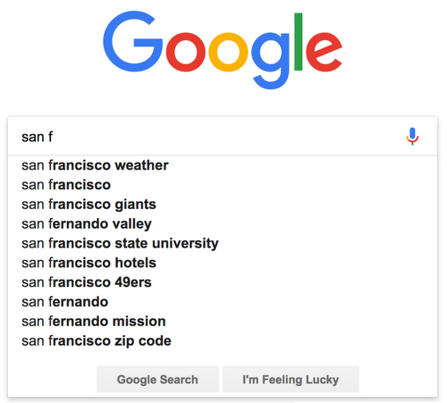
Introduction
The term text prediction means a set of computer programs and algorithms, which help users edit text with higher efficiency. It can be seen in computer and mobile device applications such as email editors, texting, and web browsers.
Auto-completion refers to the completion of a word, or a phrase, as we start typing in a document. The prediction is based upon the selection of the most likely word from a set of frequently used words.
The text prediction task consists of editing text with the minimum number of keystrokes feasible. This method is suggesting words that the user intended to write, and the system predicts the next word related to the previous work.

Slide 3
Methodology
The proposed system has multiple modules:
The text data is preprocessed using a pipeline. Using definite steps such as tokenization, stemming and lemmatization, it is then passed on to the model.
The model accepts lemmatized input and forwards it to the text extraction unit, which then branches out into the autocomplete engine, which is responsible for prediction.
The application will be deployed on streamlit. After deployment, the predictions will be tested and necessary statistics will be measure.

Slide 4
Dataset
Text data for modeling and predictions
Movie Recommendation
Autocompletion using LSTM
Source: https://www.kaggle.com/rounakbanik/the-movies-dataset
Processed and cleaned using a pipeline.
Ran 5 models for the best prediction.
Novel document
Source: http://www.gutenberg.org/cache/epub/5200/pg5200.txt
Read and cleaned using a pipeline.

Slide 5
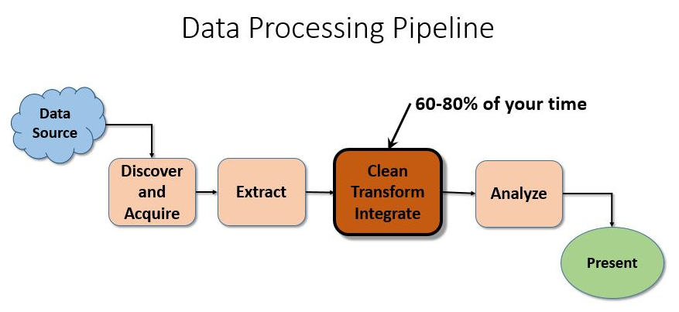
Data Cleaning
First punctuation has been removed from all the text in the document to get a uniform data set.
After cleaning the data, it was tokenized.
Next step was to import the common english stop words. More stop words have been added later to get the difference in a visual sense.
The text without stop words was stemmed and finally lemmatized.

Slide 6
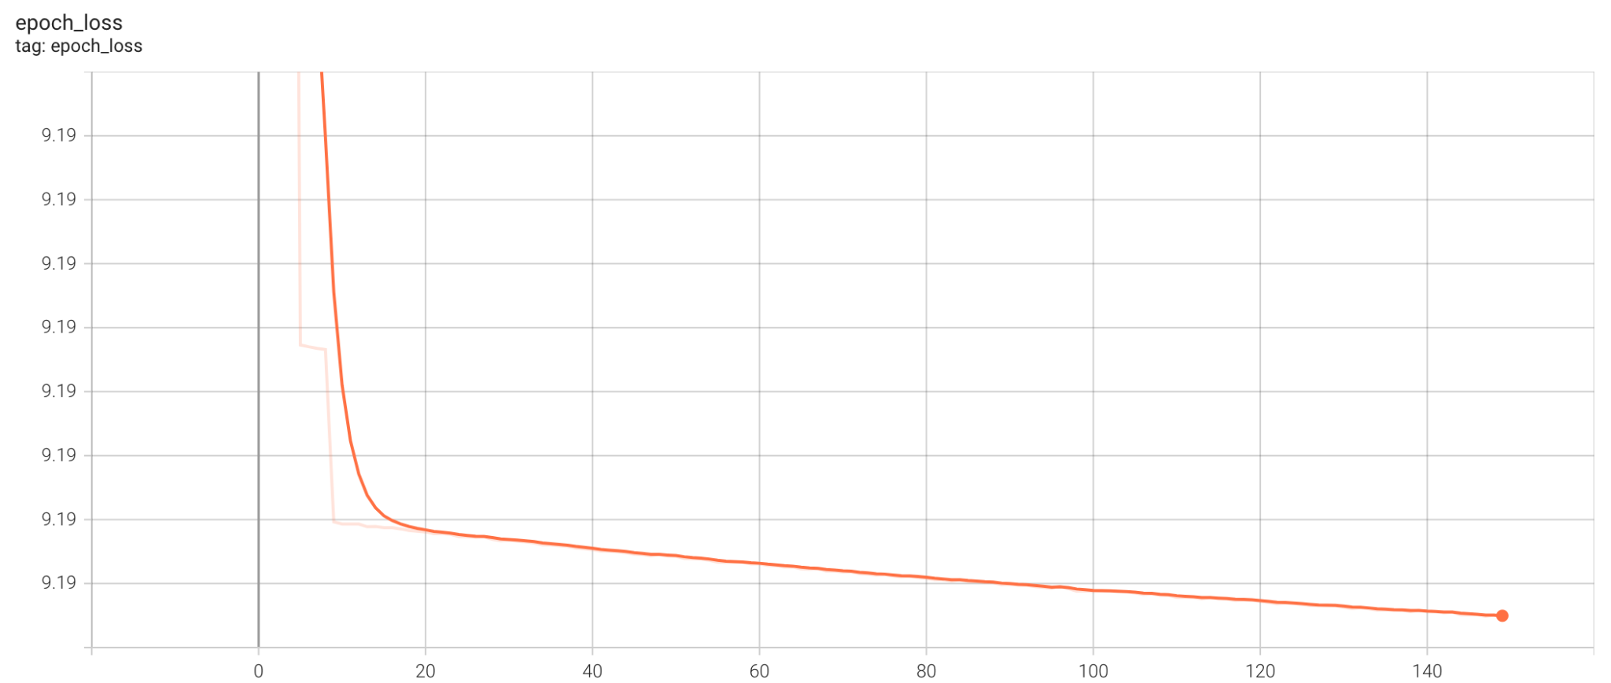
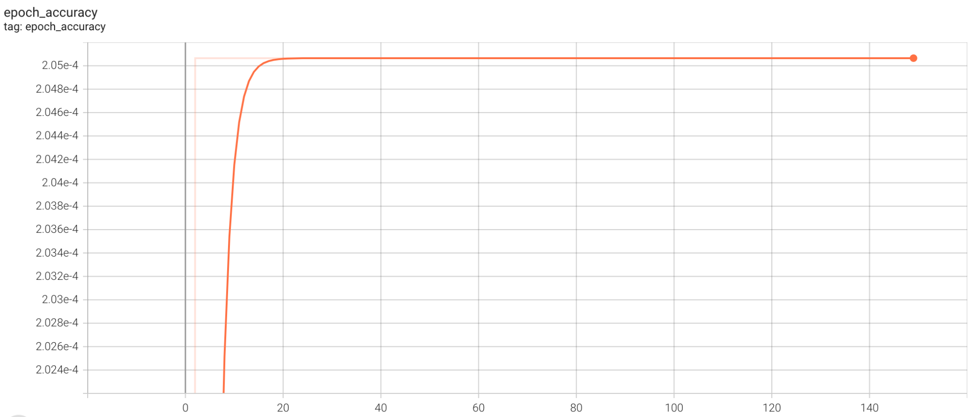
Next word prediction using LSTM
Long Short Term Memory (LSTM) networks are a type of Recurrent Neural Network that can learn order dependence. The output of the previous step is used as input in the current step in RNN.
RNN is unable to predict words stored in long-term memory but can make more accurate predictions based on current data. As for LSTM, it may keep information for a long time by default.
Notes:
L2 the square root of the sum of the squared vector values
L1 sum of the absolute values of the vector.

Slide 7
Limitations using LSTM
Considering the amount of data in hand, LSTM model takes a considerable amount of time to train. This overloads our system due to which the data had to be reduced
Reduction of data cost us with the efficiency of the model. The predicted words have been different from what was expected
The team is earnestly working to tackle this problem and hope to deliver better results by 8th December.
Notes:
L2 the square root of the sum of the squared vector values
L1 sum of the absolute values of the vector.

Slide 8
Recommending Movies based on the predicted word
The idea is to push the prediction model one step further:
Goal: To recommend top 3 movies with a complete sentence formed by the Auto-Complete prediction tool
As the efficiency is currently compromised, user will be provided with top 5 predicted words for them to make a choice.
These predictions will be based on matching genres, title and description of the movie.

Slide 9
Recommending Movies based on the predicted word - Techniques
TFIDF Vectorizer
Sentence Transformer
SPACY
Word2Vec

Slide 10
Deploying application on Streamlit
Streamlit is a free, open-source Python framework which can be used to easily build and share interactive dashboards and machine learning web apps.
Steps for deployment:
Export the ML model as a pickle (or h5 for neural networks) file
Create a streamlit interface to interact with our pickle file.
Get model results from the streamlit interface.
Deploy the streamlit app.

Slide 11
Results and Conclusions
Text prediction and autocomplete can help people to increase their writing speed by predicting the relevant words.
The model has proved efficient in prediction and completion of text
The results from recommendation algorithms add to the comfort of user allowing them to navigate better on the app.
Use of Perplexity

Slide 12
Future Scope
Dataset containing ‘sent gmail’ text message of the group members.
Retrieved using Google Takeout.
Processed, converted from mbox to txt and then cleaned using a pipeline.
Fed into our LSTM model to make an auto complete feature personal to the team members.

Slide 13
